Slide 1
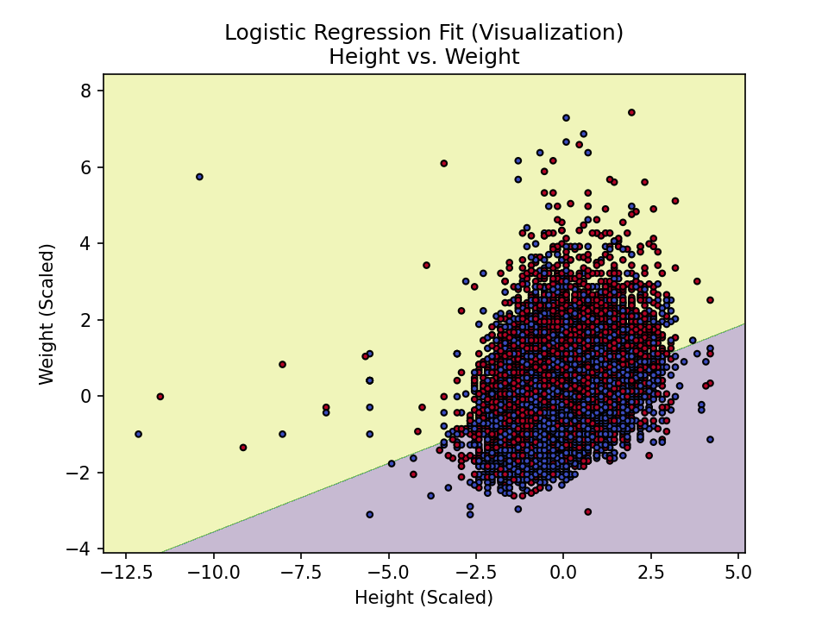
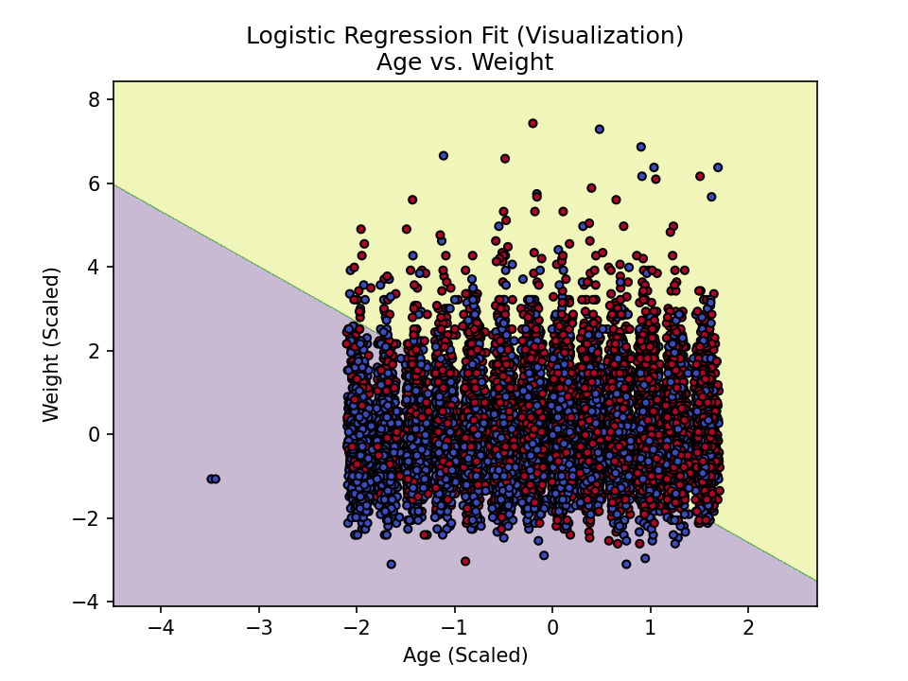
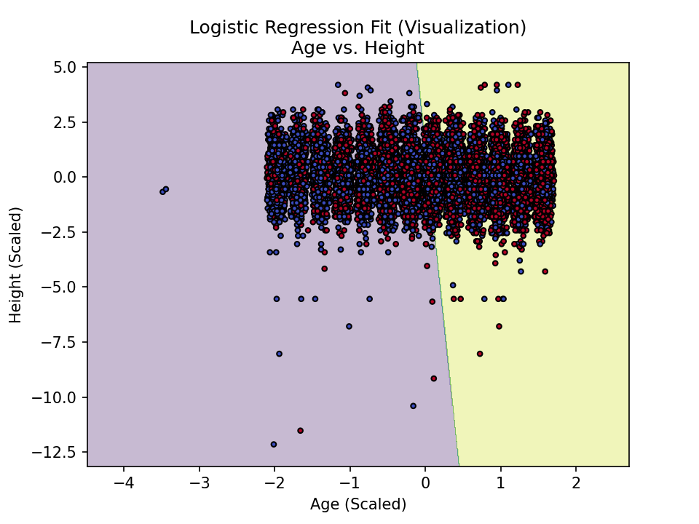
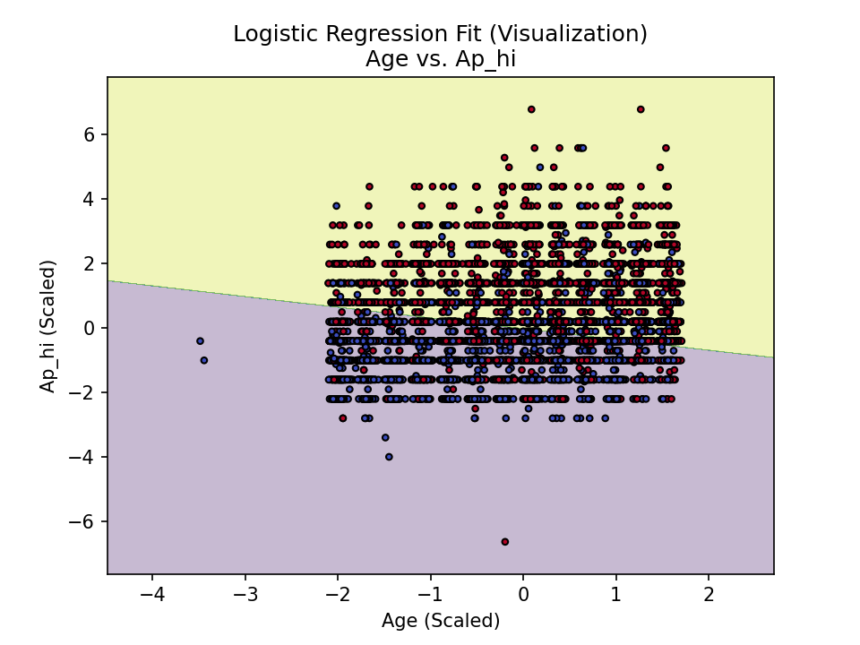
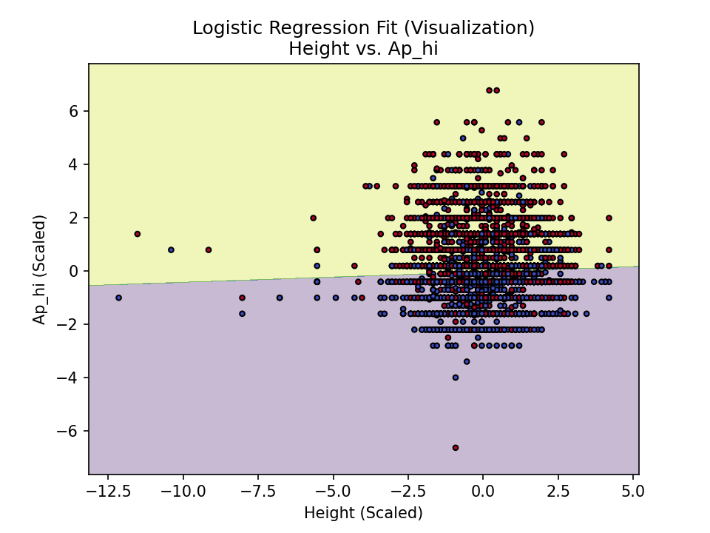
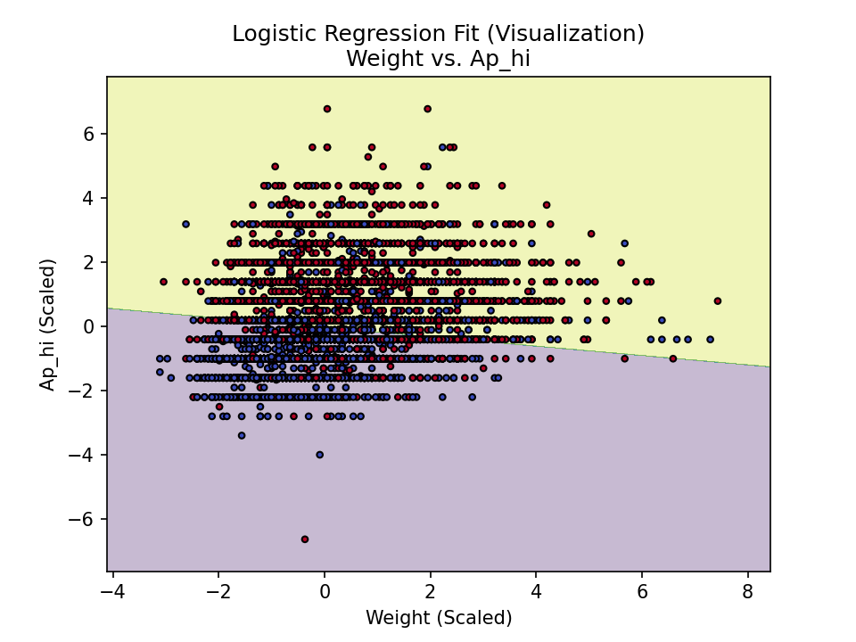

Slide 2
| Variable | Definition | Levels |
|-----------------|---------------------------------------------------------|----------------------------------------------------|
| Gender | Sex | {female, male} |
| Age Level | Age groups | min-35, 36-40, 41-45, 46-50, 51-55, 56-60, 60-max |
| BMI Level | Body Mass Index (BMI) | {[18.5,23.9], (23.9,27.9], (27.9,32.0], (32.0,max]} |
| AP Level | Blood Pressure | {Yes, No} (High pressure >= 140 and low pressure >= 90 is Yes, otherwise No) |
| Cholesterol | Cholesterol levels | {1 (Normal), 2 (Above normal), 3 (Significantly above normal)} |
| Glucose | Glucose levels | {1 (Normal), 2 (Above normal), 3 (Significantly above normal)} |
| Smoke | Smoking habit | {0 (Not often), 1 (Often)} |
| Alco | Alcohol consumption | {0 (Not often), 1 (Often)} |
| Active | Physical activity | {0 (Not often), 1 (Often)} |
| Cardio | Cardiovascular disease | {0 (No), 1 (Yes)} |
| Physiological | Physiological indicators | - |
| Medical | Medical indicators | - |
| Subjective | Subjective information | - |

Slide 3




Age
Height
Weight
Data
Gender
Ap-hi
Ap-lo
Use
Cholesterol
Gluc
Smoke
cardio
Alco
Active
Logistic regression
Train
Bayesian
Models
Python
Netica
XGboost
SPSS
Confusion matrix
Test
Predict
Accuracy
ROC Curve
Learning Curve

